Slide 1

KNOWLEDGE REPRESENTATION
Computer Science Department
University of Verona - Italy

Slide 2
UNIT 4
RECOGNITION OF ALCQIREG

Slide 3
AGENDA
ALCFI_{REG}
Equivalence of ALCQI_{REG} and ALCFI_{REG}
Translating ALCFI_{REG} in 2ATA
Hierarchies of ALC(N) and ALCQI_{REG}

Slide 4
ALCFI_{REG}
ALCFI_{REG} it is obtained by adding to ALC the regular role operators (union, composition, reflexive-transitive closure, concept identity, inverse) and the functional limit operator≤1R:C

Slide 5
REPRESENTATION OF Q IN ALCFI_{REG}
Role reification Explicit representation of Q as a functional constraint

Slide 6
ROLE REIFICATION
Given a role R we call the reified form of R the following expression
V₁⁻◦id(A_{R})◦V₂
where AR is a concept that contains pairs of elements in relation to R

Slide 7
REIFICATION OF CONCEPTS
The reification of a concept C (or reified counterpart) in ALCFI_{REG} is a rewriting of C as an intersection of two concepts:
ξ₁(C) = ξ₀(C) ⊓ Θ₁

Slide 8
STEP-BY-STEP REIFICATION
Step 1: Each role is reified using only two roles V1 and V2 (V1−◦id(AR)◦V2) [only two for each concept] Step 2: Each qualified restriction is rewritten by replacing the roles as follows:
≤nR.C is ≤n(V₁⁻◦id(A_{R})◦V₂).C is ≤nV₁⁻.(A_{R}⊓∃V₂.C)
≥nR.C is ≥n(V₁⁻◦id(A_{R})◦V₂).C is ≥nV₁⁻.(A_{R}⊓∃V₂.C)
≤nR⁻.C is ≤n(V₂⁻◦id(A_{R})◦V₁).C is ≤nV₂⁻.(A_{R}⊓∃V₁.C)
≥nR⁻.C is ≥n(V₂⁻◦id(A_{R})◦V₁).C is ≥nV₂⁻.(A_{R}⊓∃V₁.C)
Step 3: Define
Θ₁ = ∀(V₁⊔V₂⊔V₁⁻⊔V₂⁻)∗.(≤1V₁ ⊓ ≤ 1V₂)

Slide 9
EXAMPLE OF REIFICATION
∃R.C⊔≤2R.C
Step 1: You reify the roles. There's only R, so you introduce the concept A_{R} and roles V₁ and V₂ for reification;
Step 2: Reify the concepts
∃(V₁⁻◦id(A_{R})◦V₂).C
≤2V₁⁻.(A_{R}⊓∃V₂.C)
Step 3: You introduce the restriction
Θ₁ = ∀(V₁⊔V₂⊔V₁⁻⊔V₂⁻)∗.(≤1V₁ ⊓ ≤ 1V₂)
RESULT:
∃R.C⊓≤2R.C becomes
∃(V₁⁻◦id(A_{R})◦V₂).C⊔≤2V₁⁻.(A_{R}⊓∃V₂.C))⊓∀(V₁⊔V₂⊔V₁⁻⊔V₂⁻)∗.(≤1V₁ ⊓ ≤ 1V₂)

Slide 10
FUNCTIONAL REDUCTION
To map an ALCQIREG concept, we first proceed to its reification, then to the reduction to F, which then starts from the reified concept
We will, therefore, rewrite every reified concept into ξ₁(C) = ξ₀(C) ⊓ Θ₁ in functional reduction ξ₂(C) = ξ₀’(C) ⊓ Θ₂

Slide 11
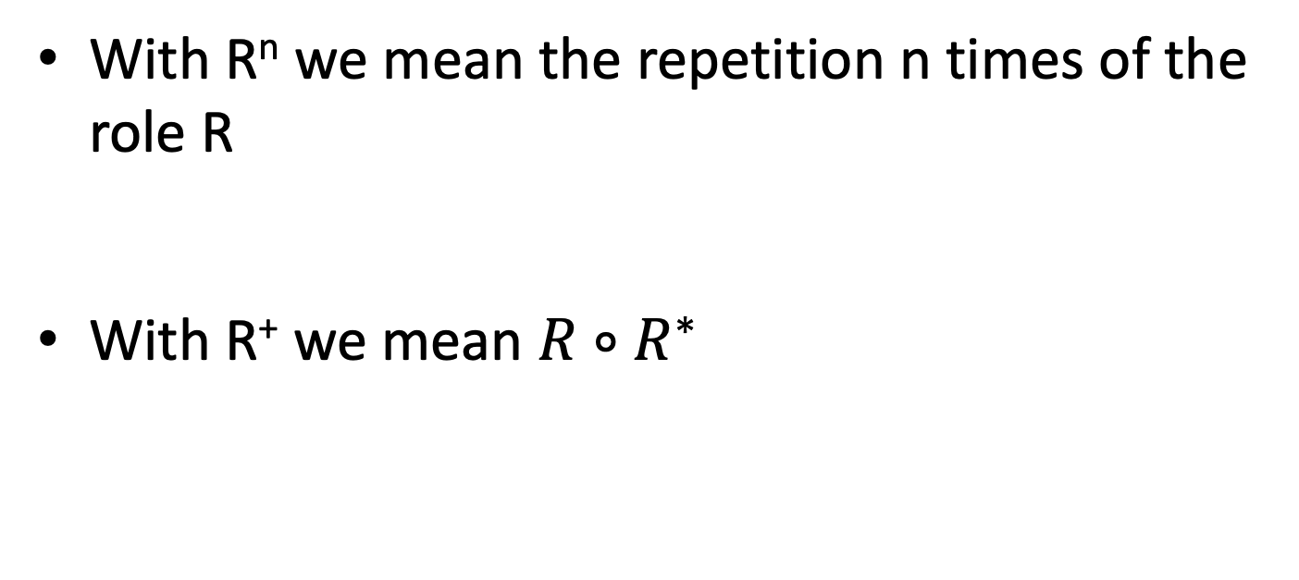
NOTATION
With R^{n} we mean the repetition n times of the role R
With R⁺ we mean $R∘R^{∗}$

Slide 12
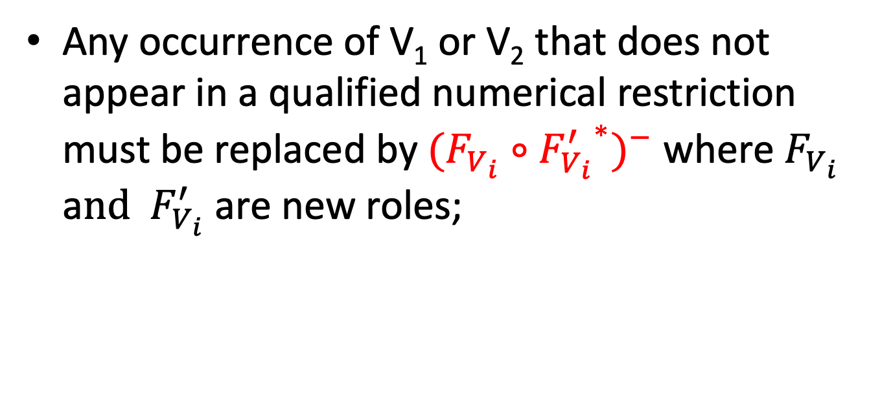
REDUCTION OF ξ₀(C)
Any occurrence of V₁ or V₂ that does not appear in a qualified numerical restriction must be replaced by${(F_{V_{i}}∘{F_{V_{i}}^{′}}^{∗})}^{−}$ where $F_{V_{i}}$ a$nd { F}_{V_{i}}^{′}$ are new roles;

Slide 13
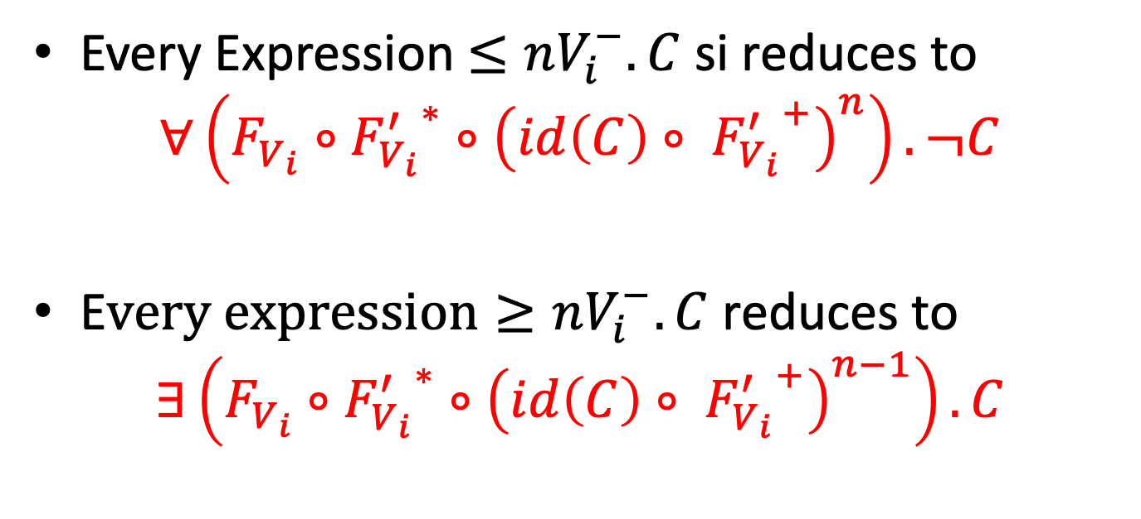
REDUCTION OF ξ₀(C) (ctd)
Every Expression$≤nV_{i}^{−}.C$ si reduces to
$$∀\left(F_{V_{i}}∘{F_{V_{i}}^{′}}^{∗}∘{\left(id\left(C\right)∘ {F_{V_{i}}^{′}}^{+}\right)}^{n}\right).¬C$$
E$very expression≥nV_{i}^{−}.C$ reduces to
$$∃\left(F_{V_{i}}∘{F_{V_{i}}^{′}}^{∗}∘{\left(id\left(C\right)∘ {F_{V_{i}}^{′}}^{+}\right)}^{n−1}\right).C$$

Slide 14
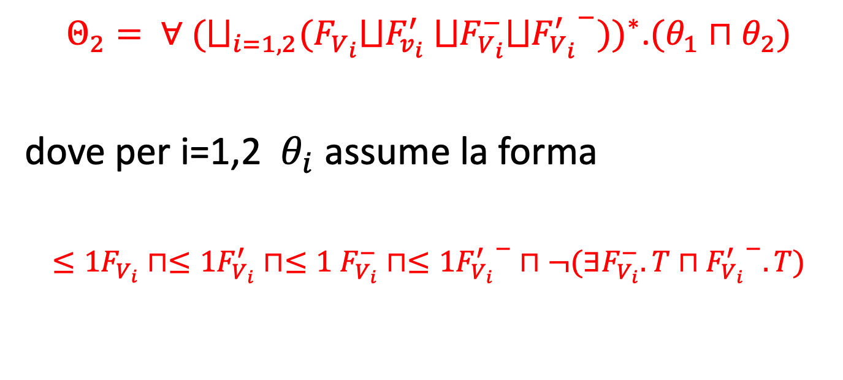
REDUCTION OF Θ₁
$Θ_{2}= ∀$ ${(⨆_{i=1,2}(F_{V_{i}}⨆F_{v_{i}}^{′} ⨆F_{V_{i}}^{−}⨆{F_{V_{i}}^{′}}^{−}))}^{∗}$.$(θ_{1}⊓θ_{2})$
where for i=1,2 $θ_{i}$ takes the form of
$≤1F_{V_{i}}⊓≤1F_{V_{i}}^{′}⊓≤1$ $F_{V_{i}}^{−}$ $⊓≤1{F_{V_{i}}^{′}}^{−}⊓¬(∃F_{V_{i}}^{−}.T⊓{F_{V_{i}}^{′}}^{−}.T)$

Slide 15
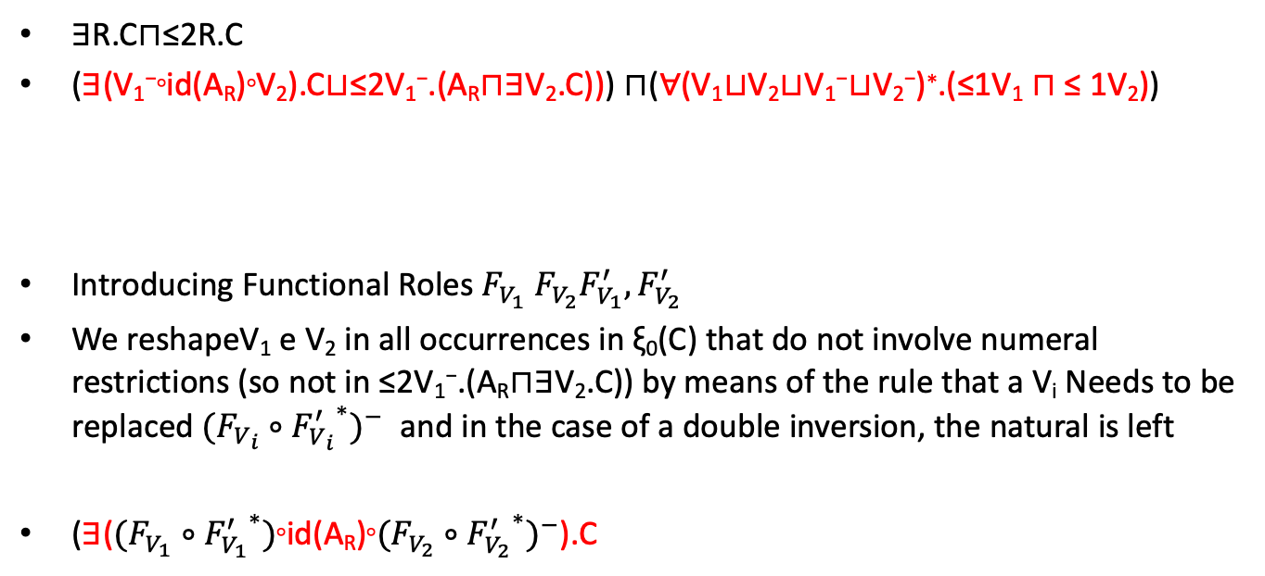
EXAMPLE
∃R.C⊓≤2R.C
(∃(V₁⁻◦id(A_{R})◦V₂).C⊔≤2V₁⁻.(A_{R}⊓∃V₂.C))) ⊓(∀(V₁⊔V₂⊔V₁⁻⊔V₂⁻)∗.(≤1V₁ ⊓ ≤ 1V₂))
Introducing Functional Roles${ F}_{V_{1}}$ $F_{V_{2}}F_{V_{1}}^{′},F_{V_{2}}^{′}$
We reshapeV₁ e V₂ in all occurrences in ξ₀(C) that do not involve numeral restrictions (so not in ≤2V₁⁻.(A_{R}⊓∃V₂.C)) by means of the rule that a V_{i} Needs to be replaced${(F_{V_{i}}∘{F_{V_{i}}^{′}}^{∗})}^{−}$ and in the case of a double inversion, the natural is left
(∃($(F_{V_{1}}∘{F_{V_{1}}^{′}}^{∗})$◦id(A_{R})◦${(F_{V_{2}}∘{F_{V_{2}}^{′}}^{∗})}^{−}$).C
ξ₀(C)
Θ₁

Slide 16
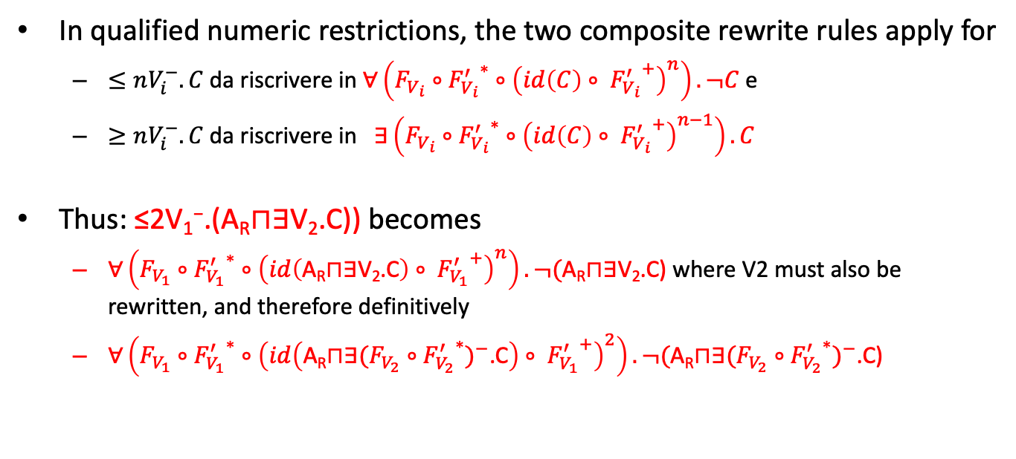
EXAMPLE (ctd)
In qualified numeric restrictions, the two composite rewrite rules apply for
$≤nV_{i}^{−}.C$ da riscrivere in $∀\left(F_{V_{i}}∘{F_{V_{i}}^{′}}^{∗}∘{\left(id\left(C\right)∘ {F_{V_{i}}^{′}}^{+}\right)}^{n}\right).¬C$e
$≥nV_{i}^{−}.C$ da riscrivere in $∃\left(F_{V_{i}}∘{F_{V_{i}}^{′}}^{∗}∘{\left(id\left(C\right)∘ {F_{V_{i}}^{′}}^{+}\right)}^{n−1}\right).C$
Thus: ≤2V₁⁻.(A_{R}⊓∃V₂.C)) becomes
$∀\left(F_{V_{1}}∘{F_{V_{1}}^{′}}^{∗}∘{\left(id\left(\text{A}\text{R}\text{⊓∃}\text{V}\text{2}\text{.}\text{C}\right)∘ {F_{V_{1}}^{′}}^{+}\right)}^{n}\right).¬(\text{A}\text{R}\text{⊓∃}\text{V}\text{2}\text{.}\text{C}\text{)}$ where V2 must also be rewritten, and therefore definitively
$∀\left(F_{V_{1}}∘{F_{V_{1}}^{′}}^{∗}∘{\left(id\left(\text{A}\text{R}\text{⊓∃}{(F_{V_{2}}∘{F_{V_{2}}^{′}}^{∗})}^{−}\text{.}\text{C}\right)∘ {F_{V_{1}}^{′}}^{+}\right)}^{2}\right).¬(\text{A}\text{R}\text{⊓∃}{(F_{V_{2}}∘{F_{V_{2}}^{′}}^{∗})}^{−}\text{.}\text{C}\text{)}$

Slide 17
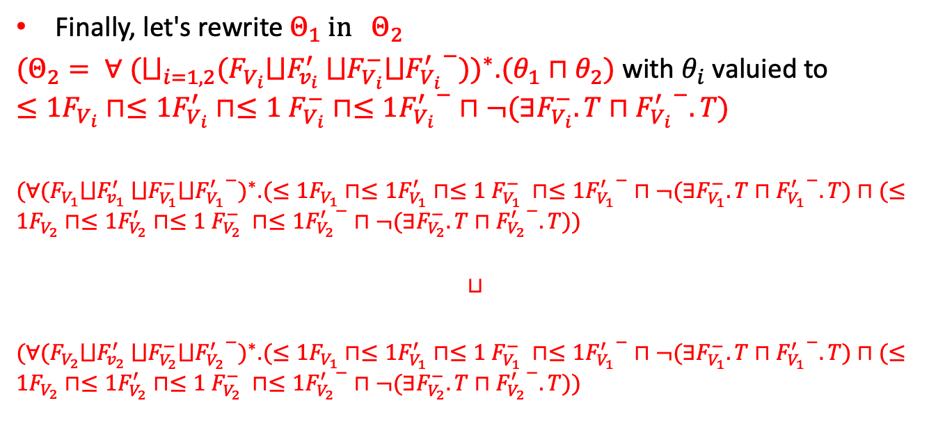
EXAMPLE (ctd)
${\text{Finally}\text{, }\text{let}\text{′}\text{s} \text{rewrite} Θ}_{1}{ in Θ}_{2}$
$(Θ_{2}= ∀$ ${(⨆_{i=1,2}(F_{V_{i}}⨆F_{v_{i}}^{′} ⨆F_{V_{i}}^{−}⨆{F_{V_{i}}^{′}}^{−}))}^{∗}$.$(θ_{1}⊓θ_{2})$ with $θ_{i}$ valuied to $≤1F_{V_{i}}⊓≤1F_{V_{i}}^{′}⊓≤1$ $F_{V_{i}}^{−}$ $⊓≤1{F_{V_{i}}^{′}}^{−}⊓¬(∃F_{V_{i}}^{−}.T⊓{F_{V_{i}}^{′}}^{−}.T)$
${(∀(F_{V_{1}}⨆F_{v_{1}}^{′} ⨆F_{V_{1}}^{−}⨆{F_{V_{1}}^{′}}^{−})}^{∗}$.$(≤1F_{V_{1}}⊓≤1F_{V_{1}}^{′}⊓≤1 F_{V_{1}}^{−} ⊓≤1{F_{V_{1}}^{′}}^{−}⊓¬(∃F_{V_{1}}^{−}.T⊓{F_{V_{1}}^{′}}^{−}.T)⊓(≤1F_{V_{2}}⊓≤1F_{V_{2}}^{′}⊓≤1 F_{V_{2}}^{−} ⊓≤1{F_{V_{2}}^{′}}^{−}⊓¬(∃F_{V_{2}}^{−}.T⊓{F_{V_{2}}^{′}}^{−}.T))$
$$⊔$$
${(∀(F_{V_{2}}⨆F_{v_{2}}^{′} ⨆F_{V_{2}}^{−}⨆{F_{V_{2}}^{′}}^{−})}^{∗}$.$(≤1F_{V_{1}}⊓≤1F_{V_{1}}^{′}⊓≤1 F_{V_{1}}^{−} ⊓≤1{F_{V_{1}}^{′}}^{−}⊓¬(∃F_{V_{1}}^{−}.T⊓{F_{V_{1}}^{′}}^{−}.T)⊓(≤1F_{V_{2}}⊓≤1F_{V_{2}}^{′}⊓≤1 F_{V_{2}}^{−} ⊓≤1{F_{V_{2}}^{′}}^{−}⊓¬(∃F_{V_{2}}^{−}.T⊓{F_{V_{2}}^{′}}^{−}.T))$

Slide 18
ALCFI_{REG} CONCEPT TRANSFORMATION
We are now translating ALCFI_{REG} in a 2ATA
The method requires some steps:
Introduction of the concept of Fischer-Ladner Closure
Construction of infinite trees as semantics of a concept
States of 2ATA as derived from ALCFI_{REG}
Construction of ALCFI_{REG} transitions

Slide 19
FISCHER-LADNER CLOSURE
Introduced for PDL (Propositional Dynamic Logic)
Analogous for ALCFI_{REG}
Can be obtained also for converse-PDL and ALCFI_{REG}

Slide 20
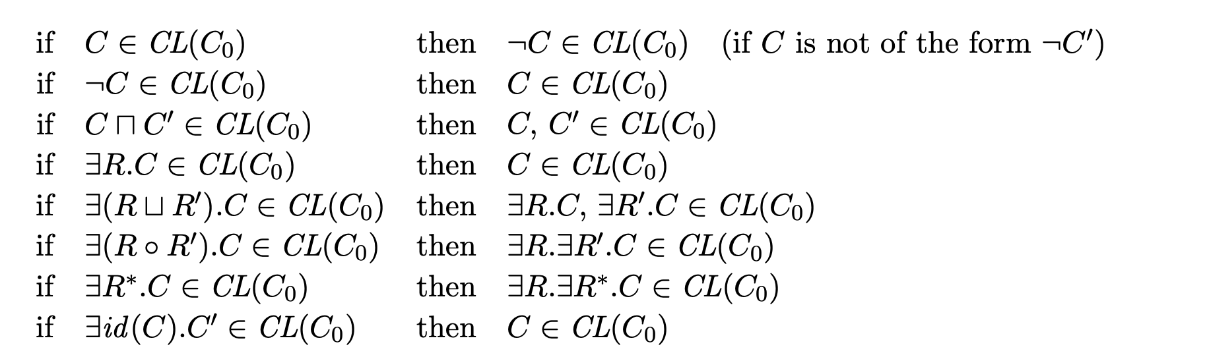
METHOD FOR CALCULATING FLC IN ALCFI_{REG}
Correspondence

Slide 21
CLOSURE
Every concept that is ALCFI_{REG}-SAT has a model that is an infinite tree with limited fanout corresponding to double of the size of its FLC

Slide 22
FISCHER-LADNER CLOSURE EXAMPLE
∃S.C⊔∀R*.(A⊓∃R*.¬C)

Slide 23
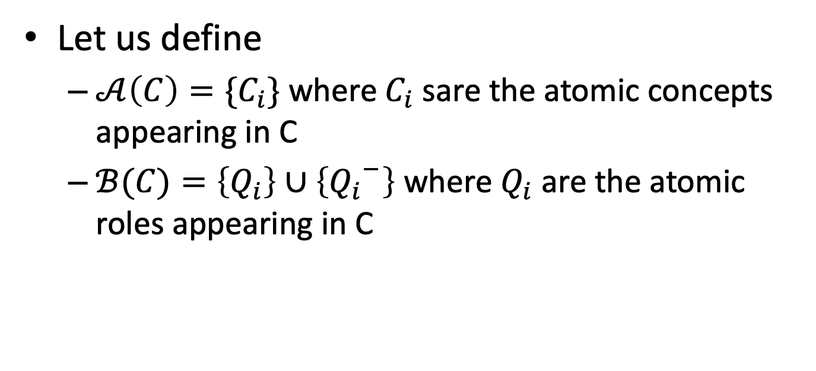
2ATA RECOGNITION
Let us define
$𝒜\left(C\right)=\{C_{i}\}$ where $C_{i}$ sare the atomic concepts appearing in C
$ℬ(C)=\left\{Q_{i}\right\}∪\left\{{Q_{i}}^{−}\right\}$ where $Q_{i}$ are the atomic roles appearing in C

Slide 24
LABELLING INFINITE TREES
La base del metodo è che l’automa che costruiamo verifichi il concetto C alla radice dell’albero
In ogni nodo dell’albero rappresenteremo due informazioni
I concetti atomici veri in quel nodo
Il ruolo atomico con cui siamo arrivati in quel nodo dal predecessore (a parte ovviamente la radice dell’albero)
L’etichetta della radice sarà quindi il concetto da riconoscere ed un ruolo fittizio (P_{dum}) usato per dire che giungiamo in quel nodo dal vuoto

Slide 25
NOTATION
By nnf(C) we mean the negative normal form of C (with innermost negations)
CL_{nnf}(C) is the set of nnf of the elements in the Fischer-Ladner closure of C

Slide 26
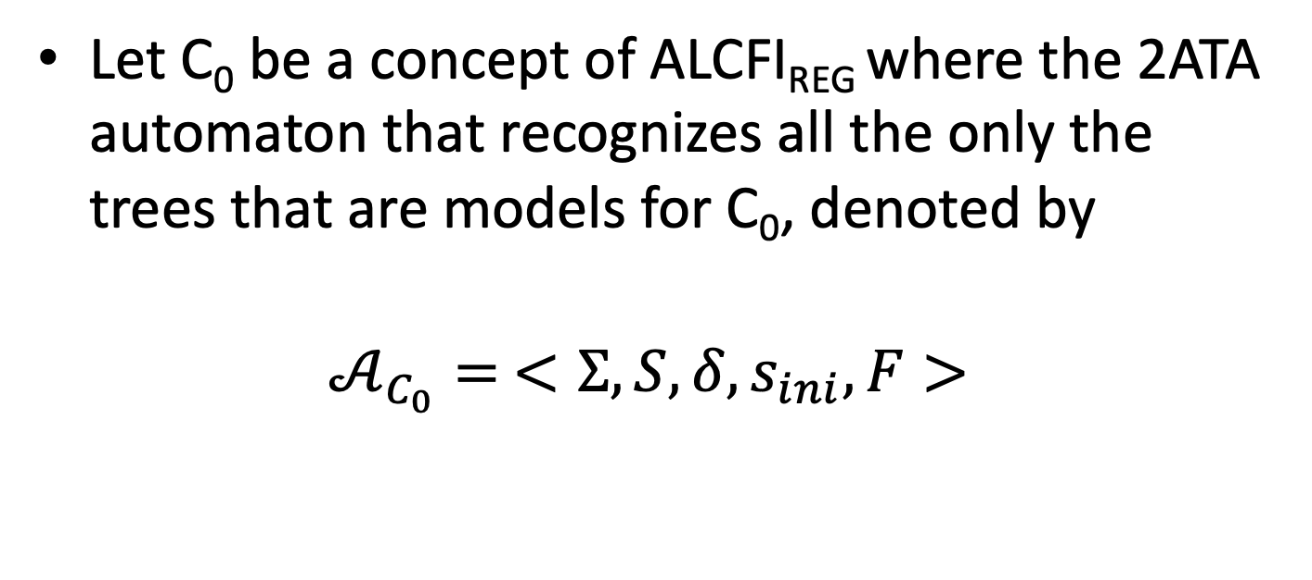
CONSTRUCTION OF THE 2ATA
Let C₀ be a concept of ALCFI_{REG} where the 2ATA automaton that recognizes all the only the trees that are models for C₀, denoted by
$$𝒜_{C_{0}}= <Σ,S,δ,s_{ini},F>$$

Slide 27

2ATA (ctd)
$Σ=2^{𝒜}×\left(ℬ∪\left\{P_{dum}\right\}\right)$
$S=\left\{s_{ini}\right\}∪{CL}_{nnf}\left(C_{0}\right)∪\left\{Q,¬Q | Q∈ℬ\right\}$

Slide 28

START
Start
Initial state, head on the root:
For any α in $2^{𝒜\left(C_{0}\right)},$
δ(s_{ini},(α,P_{dum})) = (0,nnf(C₀))

Slide 29
ELEMENTARY CONCEPT TRANSITIONS
For each atomic concept A that appears in a concept C₀, and for each element (𝝰,q) of the input alphabet,

Slide 30
ROLE ELEMENTARY TRANSITIONS
For each atomic role Q appearing in a concept C₀, and for any element (𝝰,q) of the input alphabet

Slide 31
COMPUND TRANSITIONS

Slide 32

TRANSITIONS ON FUNCTIONAL RESTRICTIONS
F$or every concept ≤1Q$and element 𝝈 of the alphabet

Slide 33

TRANSITIONS ON NEGATED FUNCTIONAL RESTRICTIONS
For any concept $¬≤1Q$and element 𝝈

Slide 34

FINAL STATES
$∀R^{∗}.C$ in the Fischer-Ladner closure

